Slide 1
INT222
More on CSS, Page Layouts & Navigation (Part 1)

Slide 2
Announcements
Lab 3 Released (Due in 2 weeks)
No Quiz Next Week!
Next Week is the Midterm Review

Slide 3
Agenda
CSS properties
background
text, font
Box model
CSS margin, border, padding, shorthand
CSS3 shadow effects

Slide 4
CSS Properties and Values
A property is assigned to a selector in order to manipulate its style.
Examples of properties include color, margin, font and many more.
A property can have one or more value. Values must be spelled exactly as described in the CSS rules.
Times New Roman and serif in the above are two value examples for the font-family.
Multiple words for any value must be in quotations
There are large number of properties and their values. We cannot cover all of them in the courses.
p { text-indent: 1em; }
#cnt2 span { text-decoration: underline overline;}
p { font-family: "Times New Roman", Serif; }

Slide 5
background - Properties
background-image:
where image.jpg may be a relative or absolute path
background-color: can still be used, and will provide colour where the image is not displayed
background-position: values: left top (default), right bottom, center center
background-repeat: values: repeat (default), repeat-x, repeat-y, no-repeat
background-size: values: width (value), height (value), contain, cover
shorthand property:
(See bg.html example)
background-image: url(image.jpg);
body{ background: url("../img/seneca_logo.gif") no-repeat grey right top;}

Slide 6
CSS3 Backgrounds
Property "background-size": specifies the size of the background image.
Before CSS3, the background image size was determined by the actual size of the image.
In CSS3 it is possible to specify the size of the background image, which allows us to re-use background images in different contexts.
You can specify the size in pixels or in percentages.
If you specify the size as a percentage, the size is relative to the width and height of the parent element.

Slide 7
CSS3 Backgrounds
Resize a background image:
(See bg_new.html example)
body {
background:url(seneca_logo.gif);
background-size: 80px 60px;
background-repeat: no-repeat;
padding-top: 40px;
}

Slide 8
CSS3 Backgrounds
Stretch the background image to completely fill the content area:
(See bg_new_100.html example)
NOTE: background-size: contain; and background-size: cover; are also useful for stretching background images when the aspect ratio must remain the same
p {
background:url(NiagaraFalls.jpg);
background-size: 100% 100%; /* contain or cover works here too */
background-repeat: no-repeat;
padding-top: 40px;
}

Slide 9

CSS3 Backgrounds
Property “background-origin”:
Specifies the positioning area of the background images.
The background image can be placed within the content-box, padding-box, or border-box area.
(See bg_new_origin.html example)

Slide 10
Formatting Text: font-family Properties
A font family is a list of one or more fonts that will be applied by a web browser to some text.
The font family can use a specific named font, but the actual appearance will depend on the browser and the fonts installed on the system.
eg: a default installation of I.E. always displays serif and Times as Times New Roman, and sans-serif and Helvetica as Arial.
A font-family consists of a set of related fonts, grouped as font families

Slide 11
Formatting Text: font-family
The web browser will only be able to apply a font if it is available on the system on which it operates, which is not always the case.
So, list in preferential order font families to use when rendering text.
The font list is separated by commas.
To avoid unexpected results, the last font family on the font list should be one of the five generic families which are by default always available in HTML and CSS.

Slide 12
Formatting Text: font-family
<!-- font.html -->
<!DOCTYPE html>
<html lang="EN">
<head>
<title> FONT </title>
<meta charset="UTF-8">
<style type="text/css">
p.serif {font-family: Times New Roman, Times, serif;}
p.sansserif {font-family: Arial, Helvetica, sans-serif;} /* if Arial is not available, choose Helvetica, … */
</style>
</head>
<body>
<h1> CSS font-family </h1>
<p class="serif"> This is a paragraph, shown in the Times New Roman font. </p>
<p class="sansserif"> this is a paragraph, shown in the Arial font. </p>
</body>
</html>

Slide 13
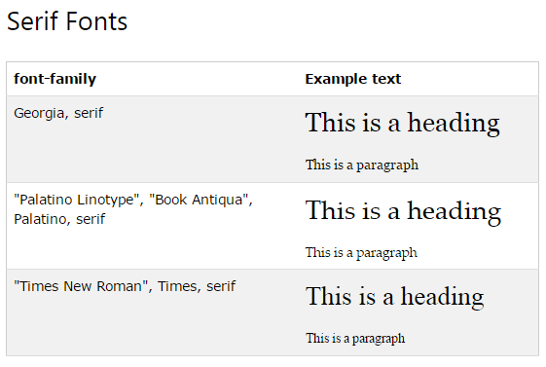
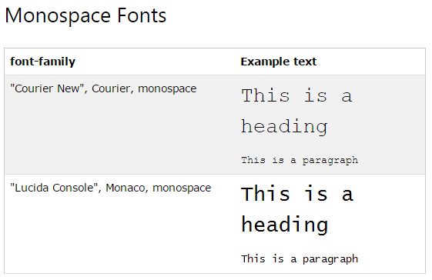
CSS Web Safe Font Combinations
( source: W3Schools: http://www.w3schools.com/cssref/css_websafe_fonts.asp ) - see for a list of Sans-Serif combinations

Slide 14
Formatting Text: font-size
Font size for different elements
h1 { font-size:250%; } – size relative to regular size (scales well)
p { font-size: 20pt; } – actual size in points,
div { font-size:20px; } – actual size in pixels,
a { font-size: smaller; } – smaller than regular size, default medium,
h1 { font-size: 1.5em; } – size relative to regular size (scales well)

Slide 15
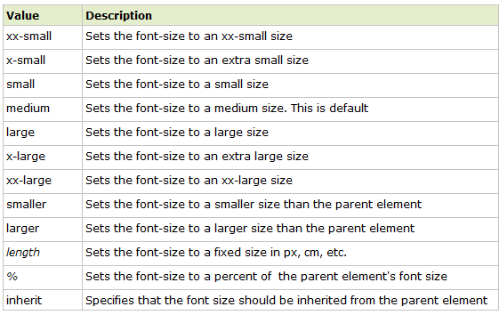
font-size: Property Values

Slide 16
Formatting Text: other text properties
{ font-weight: bold; } or “lighter”, “normal”, “bolder”
{ font-weight:700 ; } or 100, 200, 300, 400(normal), 500,600, 700 (bold), 800, 900
{ font-style: italic; } or “normal”, “oblique”
{ text-align: center; } or “left” (normal), “right”, “justify”
{ text-indent: 4em; } first-line indent, can use %, pt, px
{ text-indent: -4em; } hanging indent (pushes first-line to the left)

Slide 17
Formatting Text: other text properties
{ text-decoration: underline; } or “overline”, “line-through”, “blink”, “none”
{ text-transform: capitalize; } or “uppercase”, “lowercase”, “none”
{ font-variant: small-caps; } or “normal”
Shorthand:
(See font_2.html & text.html examples)
h2 {
font: italic small-caps bolder "Lucida","Arial";
text-decoration:underline;
text-align:right;
color:red;
background-color:silver;
}

Slide 18
CSS3 Text Effects
Text shadow:
Specify horizontal shadow, the vertical shadow, the blur distance, and the color of the shadow, eg:
(See text_css3.html example)
h1 {text-shadow: 5px 5px 5px red;}

Slide 19
CSS3 Text Effects
CSS3 word wrapping
If a word is too long to fit within an area, it expands outside
In CSS3, the word-wrap property allows to force the text to wrap, even if it means splitting it in the middle of a word, eg:
(See text_css3.html example)
p.wrap { word-wrap: break-word; }

Slide 20
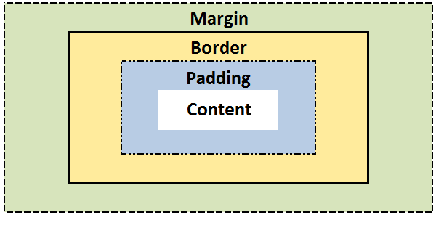
The CSS Box model
All elements can be considered to be box.
The box model is the specification that defines how a box and its attributes relate to each other.
A box is made up of four distinct parts:

Slide 21
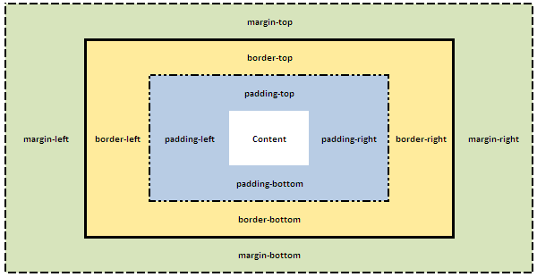
The CSS Box model – Detail
(See box-model.html example)

Slide 22
The CSS Box model – Shorthand
CSS Shortcuts allow for a property to have a single or multiple values.
Shortcuts/shorthand order: CLOCKWISE:
top -> right -> bottom -> left

Slide 23
The CSS Box Model – Margin
CSS Margins define the white space around an HTML element's border. See the "Box model".
CSS Centering Trick: "margin: 0 auto;" will center an element horizontally with an explicit width (ie: 300px)
margin | Applies to all sides
margin: 6px; /* this is a shortcut */ | Applies a margin to all sides of an element
margin-top | Applies a margin to the top of an element
margin-right | Applies a margin to the right of an element
margin-bottom | Applies a margin to the bottom of an element
margin-left | Applies a margin to the left of an element

Slide 24
The CSS Box Model – Margin Shorthand
To set all the margin properties in one declaration:
margin:10px 5px 15px 20px;
top margin is 10px
right margin is 5px
bottom margin is 15px
left margin is 20px
margin:10px 5px 15px;
top margin is 10px
right and left margins are 5px
bottom margin is 15px
margin:10px 5px;
top and bottom margins are 10px
right and left margins are 5px
margin:10px;
all four margins are 10px

Slide 25

The CSS Box Model – Margin Collapsing
Top and bottom margins of blocks are sometimes combined (collapsed) into a single margin whose size is the largest of the margins combined into it, a behavior known as margin collapsing.
h1 { margin: 0 0 25px 0; background: #cfc; }
p { margin: 20px 0 0 0; background: #cf9; }
http://www.sitepoint.com/web-foundations/collapsing-margins/

Slide 26
The CSS Box Model – Border
The border property allows for setting the width, style and color and of the borders around an element.
The border style property value for the border must be stated, otherwise no border will show up.

Slide 27
The CSS Box Model – border-width
The border-width Property
The border-width can be set in pixels, ems, or one of the three pre-defined values: thin, medium, or thick.
(See border-width.html example)
border-width | Applies to all sides
border-width: 6px; border-style: solid; | Applies a solid border to all sides
border-top-width | Applies only to the top border
border-right-width | Applies only to the right border
border-bottom-width | Applies only to all bottom border
border-left-width | Applies only to the left border

Slide 28
border-width Shorthand
(See border-short.html example)
Example | Description
border-width:6px; | adds a border - 6px to all four sides
border-width:6px 12px; | adds a border - 6px to top and bottom - 12px to the right and left
border-width:6px 12px 10px; | adds a border - 6px to the top, 12px to the right, 10px to bottom and 12px to the left
border:6px solid red; | width, style, color

Slide 29
The CSS Box Model – border-style
The border-style property
can have from one to four values from the list of
dotted , dashed , solid , double , groove , ridge , inset , outset , hidden.
(See border-style.html example)
border-style | Applies to
border-style:solid; /* default width of 3px */ | Applies a solid border to all sides
border-top-style | Applies the style only to the top border
border-right-style | Applies the style only to the right border
border-bottom-style | Applies the style only to all bottom border
border-left-style | Applies the style only to the left border

Slide 30
The CSS Box Model – border-color
The border-style property
(See border-color.html example)
border-color | Applies to
border-color:#ff0000; border-style: solid; | Applies a solid border to all sides
border-top-color | Applies only to the top border
border-right-color | Applies only to the right border
border-bottom-color | Applies only to all bottom border
border-left-color | Applies only to the left border

Slide 31
The CSS Box Model – border shorthand
Specify all the individual border properties in one property.
The border property is a shorthand for the following individual border properties:
border-width
border-style (required)
border-color
border: 5px solid red;

Slide 32
The CSS Box Model - padding
CSS Padding property defines the white space around the inside of an HTML element's border. See the "Box model".
(See box-padding.html example)
padding | Applies to all sides
padding:6px; /* this a short cut */ | Applies padding to all sides of an element
padding-top | Applies padding to the top of an element
padding-right | Applies padding to the right of an element
padding-bottom | Applies padding to the bottom of an element
padding-left | Applies padding to the left of an element

Slide 33
CSS3 Rounded Corners
Property: border-radius
Example:
(See boxShadow_roundedCorners.html example)
div {
border: 2px solid #a1a1a1;
padding: 10px 40px;
background: grey;
width: 300px;
border-radius:250px;
/* border-radius:10%; */
}

Slide 34
CSS3 Rounded Corners – Shorthand
border-radius: 2em;
is equivalent to:
border-top-left-radius: 2em;
border-top-right-radius: 2em;
border-bottom-right-radius: 2em;
border-bottom-left-radius: 2em;

Slide 35
CSS3 Box Shadow
CSS3 provides not only text-shadow but also box-shadow effects.
Property: box-shadow
box-shadow value: h-shadow v-shadow blur spread color inset;
(See boxShadow_roundedCorners.html example)

Slide 36
CSS3 Box Shadow
(see css-ball.html example)
box shadow generator: http://www.cssmatic.com/box-shadow
Value | Description
h-shadow | Required. The position of the horizontal shadow. Negative values are allowed
v-shadow | Required. The position of the vertical shadow. Negative values are allowed
blur | Optional. The blur distance
spread | Optional. The size of shadow
color | Optional. The color of the shadow. The default value is black. Look at CSS Color Values for a complete list of possible color values.
inset | Optional. Changes the shadow from an outer shadow (outset) to an inner shadow

Slide 37
Useful Links
CSS Reference
http://reference.sitepoint.com/css
Box model - CSS | MDN
https://developer.mozilla.org/en-US/docs/Web/CSS/box_model
CSS Properties
http://reference.sitepoint.com/css/propertyref
CSS Selectors
http://reference.sitepoint.com/css/selectorref

Slide 38
Questions?
Any questions?
Would you like to see any more examples?

